Slide 1
Recursion Stop annoying me
Mostafa Saad
Teaching Assistant
Cairo University

Slide 2
Recursion?
Let F(n) = 1 * 2 * 3 * ….. N
So F(6) = 1 * 2 * 3 * 4 * 5 * 6
So F(5) = 1 * 2 * 3 * 4 * 5
Could we use F(5) as part of F(6)?
F(6) = 6 * F(5)
Function F could be written Recursively IFF it needs to do same behavior as F but on smaller input size.
As smaller input will call less smaller one, we will end at some. Those we need terminating state
This is called base case

Slide 3
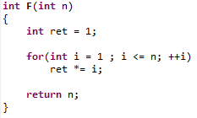
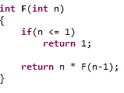
Code?
Factorial Method
Linear Recursion: only 1 sub-call

Slide 4
Life is complex
Recursion has many types
Each type has many complex problem
Thinking recursively is natural, but need good amount of training.
What happens in memory when we call functions?
This should help us tracing recursion

Slide 5
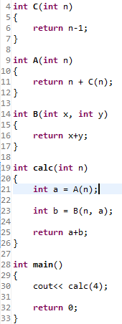
Console Value?
Line 30: call calc(4)
Line 21: call A(4)
Line 11: return 4 + call C(4)
Line 6: return 3
Back to line 11
Line 11: return 4 + 3
Back to line 21: a = 7
Line 23: call B(4, 7)
Line 16: return 4+7
Back to line 23
Line 23: b = 11
Line 25: return a+b = 11+7
Line 30 displays 18

Slide 6
The run-time stack
Stack is like box of books. You put books. When you need to get a book, you take the last one first. Need one more book? Pick next book.
TOP OF THE STACK
TOP OF THE STACK
Notes:
Image src: Src: http://www.cse.unr.edu/~bebis/CS302/Lectures/Stacks.ppt

Slide 7
The run-time stack
The run-time stack is stack of function calls
When we call function, it enters stack. When we finish function, we remove it from stack
Each element in stack, will have all details for the function
What are sent parameters
Who/Where called us and waiting our return

Slide 8
Run Time Stack

Slide 9
Main()
Run Time Stack

Slide 10
Main()
Line 30: Calc(4)
Run Time Stack

Slide 11
Calc(n=4, Called from line 30)
Main()
Line 30: Calc(4)
Run Time Stack

Slide 12
Calc(n=4, Called from line 30)
Line 21: a = A(4)
Main()
Line 30: Calc(4)
Run Time Stack

Slide 13
A(n=4, Called from line 21)
Calc(n=4, Called from line 30)
Line 21: a = A(4)
Main()
Line 30: Calc(4)
Run Time Stack

Slide 14
A(n=4, Called from line 21)
Line 11: return 4 + C(4)
Calc(n=4, Called from line 30)
Line 21: a = A(4)
Main()
Line 30: Calc(4)
Run Time Stack

Slide 15
C(n=4, Called from line 11)
A(n=4, Called from line 21)
Line 11: return 4 + C(4)
Calc(n=4, Called from line 30)
Line 21: a = A(4)
Main()
Line 30: Calc(4)
Run Time Stack

Slide 16
C(n=4, Called from line 11)
return to line 11 with: 4-1
A(n=4, Called from line 21)
Line 11: return 4 + C(4)
Calc(n=4, Called from line 30)
Line 21: a = A(4)
Main()
Line 30: Calc(4)
Run Time Stack

Slide 17
A(n=4, Called from line 21)
Line 11: return 4 + 3
Calc(n=4, Called from line 30)
Line 21: a = A(4)
Main()
Line 30: Calc(4)
Run Time Stack

Slide 18
Calc(n=4, Called from line 30)
Line 21: a = 7
Main()
Line 30: Calc(4)
Run Time Stack

Slide 19
Calc(n=4, Called from line 30)
Line 21: a = 7
Line 23: b = B(4, 7)
Main()
Line 30: Calc(4)
Run Time Stack

Slide 20
B(x=4, y=7, Called from line 23)
Calc(n=4, Called from line 30)
Line 21: a = 7
Line 23: b = B(4, 7)
Main()
Line 30: Calc(4)
Run Time Stack

Slide 21
B(x=4, y=7, Called from line 23)
return 4+7
Calc(n=4, Called from line 30)
Line 21: a = 7
Line 23: b = B(4, 7)
Main()
Line 30: Calc(4)
Run Time Stack

Slide 22
Calc(n=4, Called from line 30)
Line 21: a = 7
Line 23: b = 11
Main()
Line 30: Calc(4)
Run Time Stack

Slide 23
Calc(n=4, Called from line 30)
Line 21: a = 7
Line 23: b = 11
return 7+11
Main()
Line 30: Calc(4)
Run Time Stack

Slide 24
Main()
Line 30: 18
Run Time Stack

Slide 25
Main()
Line 30: 18
Line 32: return 0
Run Time Stack

Slide 26
Program Terminated
Run Time Stack

Slide 27
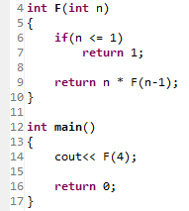
Similarly
Run Time Stack

Slide 28
Similarly
Main()
Line 14: F(4)
Run Time Stack

Slide 29
Similarly
F(n=4, Called from line 14)
Line 9: return n * F(3)
Main()
Line 14: F(4)
Run Time Stack

Slide 30
Similarly
F(n=3, Called from line 9)
Line 9: return 3 * F(2)
F(n=4, Called from line 14)
Line 9: return 4 * F(3)
Main()
Line 14: F(4)
Run Time Stack

Slide 31
Similarly
F(n=2, Called from line 9)
Line 9: return 2 * F(1)
F(n=3, Called from line 9)
Line 9: return 3 * F(2)
F(n=4, Called from line 14)
Line 9: return 4 * F(3)
Main()
Line 14: F(4)
Run Time Stack

Slide 32
Similarly
F(n=1, Called from line 9)
Line 6: return 1
F(n=2, Called from line 9)
Line 9: return 2 * F(1)
F(n=3, Called from line 9)
Line 9: return 3 * F(2)
F(n=4, Called from line 14)
Line 9: return 4 * F(3)
Main()
Line 14: F(4)
Run Time Stack

Slide 33
Similarly
F(n=2, Called from line 9)
Line 9: return 2 * 1
F(n=3, Called from line 9)
Line 9: return 3 * F(2)
F(n=4, Called from line 14)
Line 9: return 4 * F(3)
Main()
Line 14: F(4)
Run Time Stack

Slide 34
Similarly
F(n=3, Called from line 9)
Line 9: return 3 * 2 * 1
F(n=4, Called from line 14)
Line 9: return 4 * F(3)
Main()
Line 14: F(4)
Run Time Stack

Slide 35
Similarly
F(n=4, Called from line 14)
Line 9: return 4 * 3 * 2 * 1
Main()
Line 14: F(4)
Run Time Stack

Slide 36
Similarly
Main()
Line 14: 4*3*2*1=24
Run Time Stack

Slide 37
Similarly
Run Time Stack

Slide 38
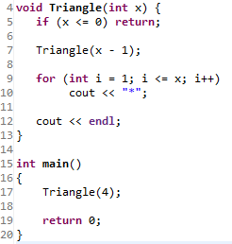
Your turn => Behave as a Computer

Slide 39
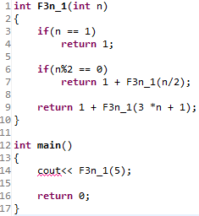
Your turn => Behave as a Computer

Slide 40
The 3n+1 function
Starting from n,
if odd moves to 3n+1
If even moves to n/2
If 1, stop
Previous function return length of sequence
5 16 8 4 2 1

Slide 41
Binary Functions
So far, functions just has 1 call (even 3n+1)
If function calls up to 2 calls, we call it a binary function
More challenging in thinking.
There are many patterns, if you used to them, you figure it easily. See the dynamic programming series

Slide 42
N choose K
How to write N choose K recursively?
We have N persons and would like to pick K only
What could we do with the first person? Pick him or leave
If we picked, then our sub-problem became?
If we left him, our sub-problem became?

Slide 43
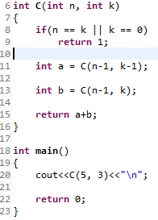
Your turn => Behave as a Computer

Slide 44
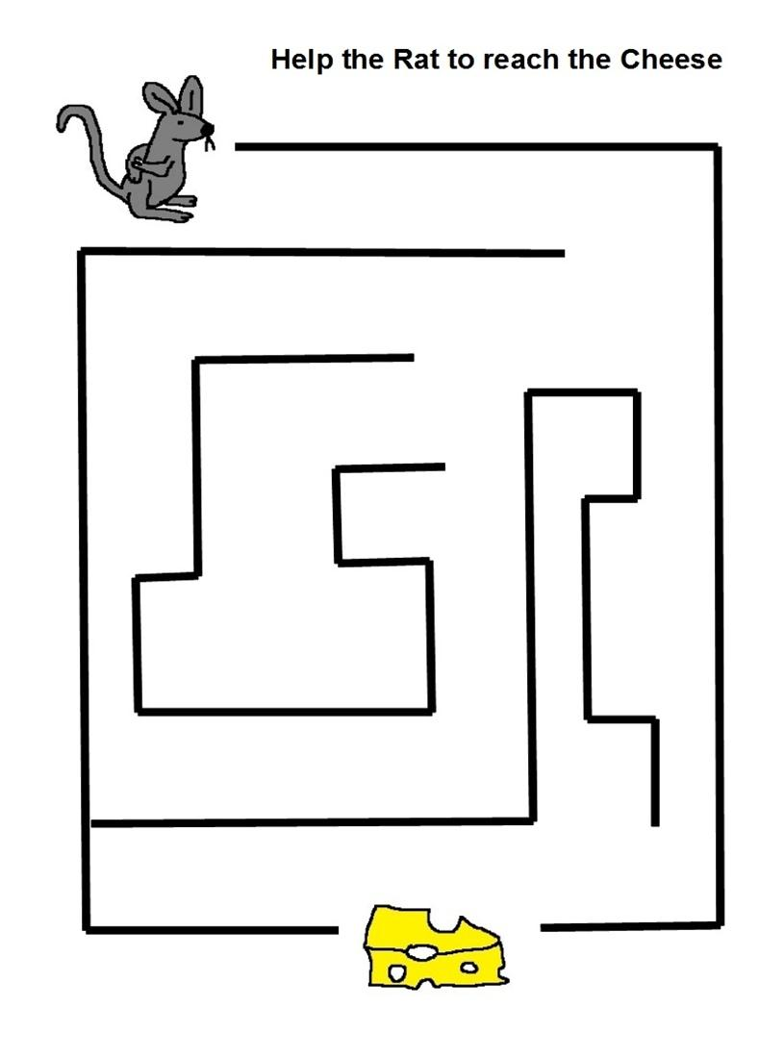
Maze
Notes:
Src: http://www.studyvillage.com/attachments/Resources/2892-13237-Maze4.jpg

Slide 45
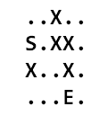
Maze
Do you feel with the recursion?
From any cell I want to do search.
So all cells do same task
What could be our function?
Location = Cell = Row, Col
Bool search(int r, int c)
What could be our calls?
From each cell try the 4 possible direction
Be careful to not move in X
And base case?
When we reach the E

Slide 46
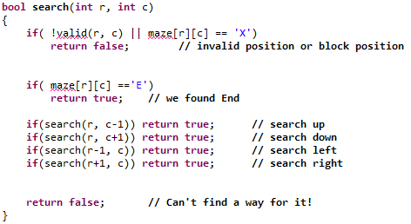
Code?

Slide 47

Trace
Search(0, 0)

Slide 48
Important facts
Recursive call must result in smaller state
Or it will go to infinity!
Sometimes, recursion back to a point we already searched/searching for it
Simply, we shouldn’t recurse from it again
To do, we use a Boolean array to mark the used cells so far

Slide 49
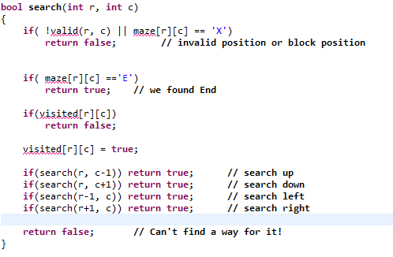
Modified Code

